Slide 1
Day Zero Introductions Installing JDK 11 Java Review Git
CSC 143: Programming II
North Seattle College
SPRING 2020 quarter
Brian Cui

Slide 2
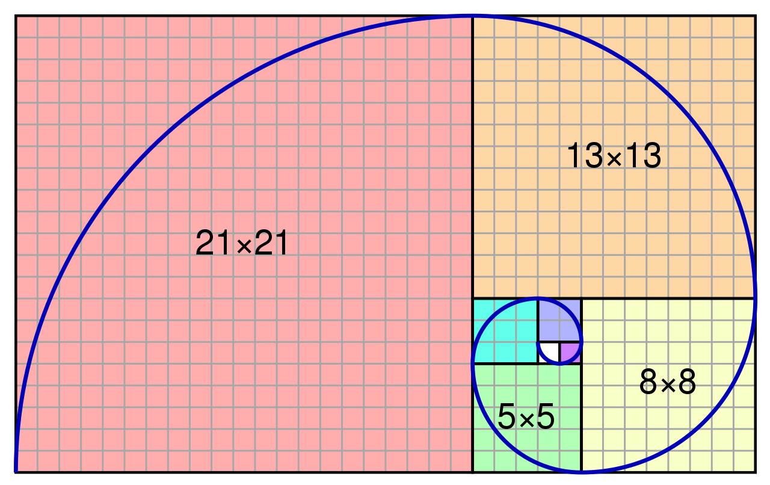
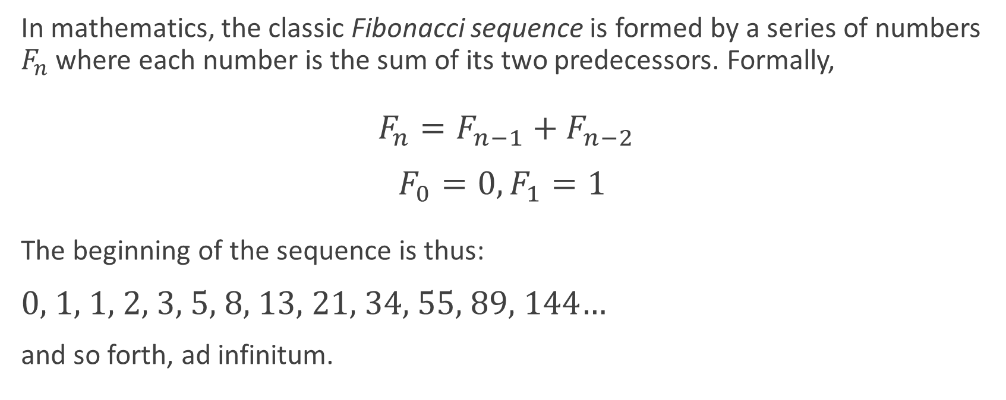
On Fibonacci Numbers and why we care
In mathematics, the classic Fibonacci sequence is formed by a series of numbers $F_{n}$ where each number is the sum of its two predecessors. Formally,
$F_{n}=F_{n−1}+F_{n−2}$
$F_{0}=0, F_{1}=1$
The beginning of the sequence is thus:
0, 1, 1, 2, 3, 5, 8, 13, 21, 34, 55, 89, 144…
and so forth, ad infinitum.

Slide 3
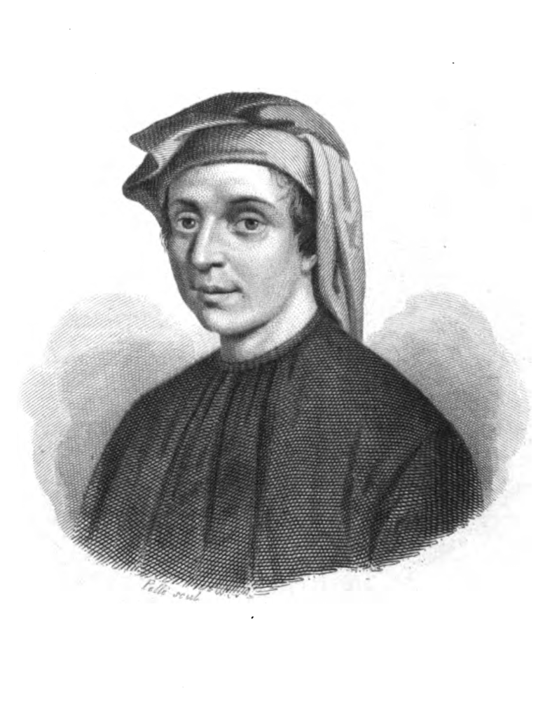
On Fibonacci Numbers and why we care
Now consider the following recursive Python function:
def fib(i):
if i == 0:
return 0
elif i == 1:
return 1
else:
return fib(i - 1) + fib(i - 2)
Leonardo Fibonacci
1170-1250

Slide 4
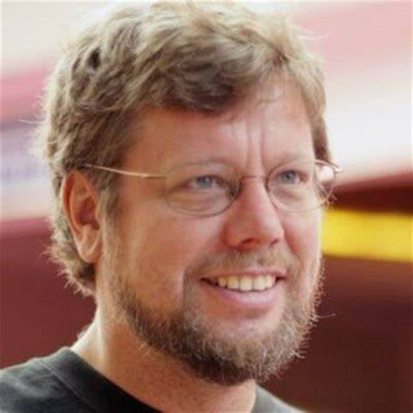
On Fibonacci Numbers and why we care
Now consider the following recursive Python function:
def fib(i):
if i == 0:
return 0
elif i == 1:
return 1
else:
return fib(i - 1) + fib(i - 2)
for i in range(10):
print(fib(i))
0, 1, 1, 2, 3, 5, 8, 13, 21, 34

Slide 5
On Fibonacci Numbers and why we care
Now consider the following recursive Python function:
def fib(i):
if i == 0:
return 0
elif i == 1:
return 1
else:
return fib(i - 1) + fib(i - 2)
fib(5000)
(How long will it take Mr. Guido van Rossum to respond?)
Instantly
5 seconds
50 seconds
5 hours
5 billion years+

Slide 6
On Fibonacci Numbers and why we care
Now consider the following recursive Python function:
def fib(i):
if i == 0:
return 0
elif i == 1:
return 1
else:
return fib(i - 1) + fib(i - 2)
fib(5000)
(How long will it take Mr. Guido van Rossum to respond?)
Instantly
5 seconds
50 seconds
5 hours
5 billion years+

Slide 7
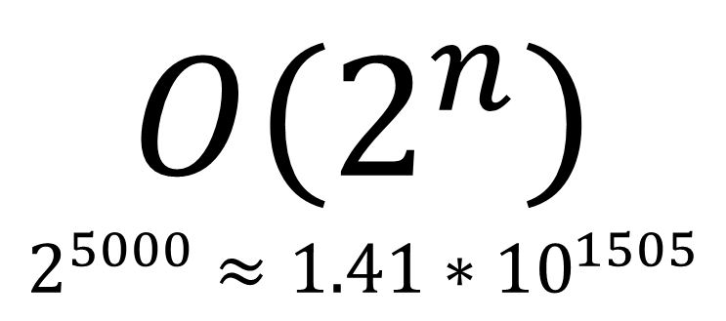
Instantly
5 seconds
50 seconds
5 hours
5 billion years+
What happened?
Now consider the following recursive Python function:
def fib(i):
if i == 0:
return 0
elif i == 1:
return 1
else:
return fib(i - 1) + fib(i - 2)
$$O\left(2^{n}\right)$$
$$2^{5000}≈1.41∗{10}^{1505}$$

Slide 8
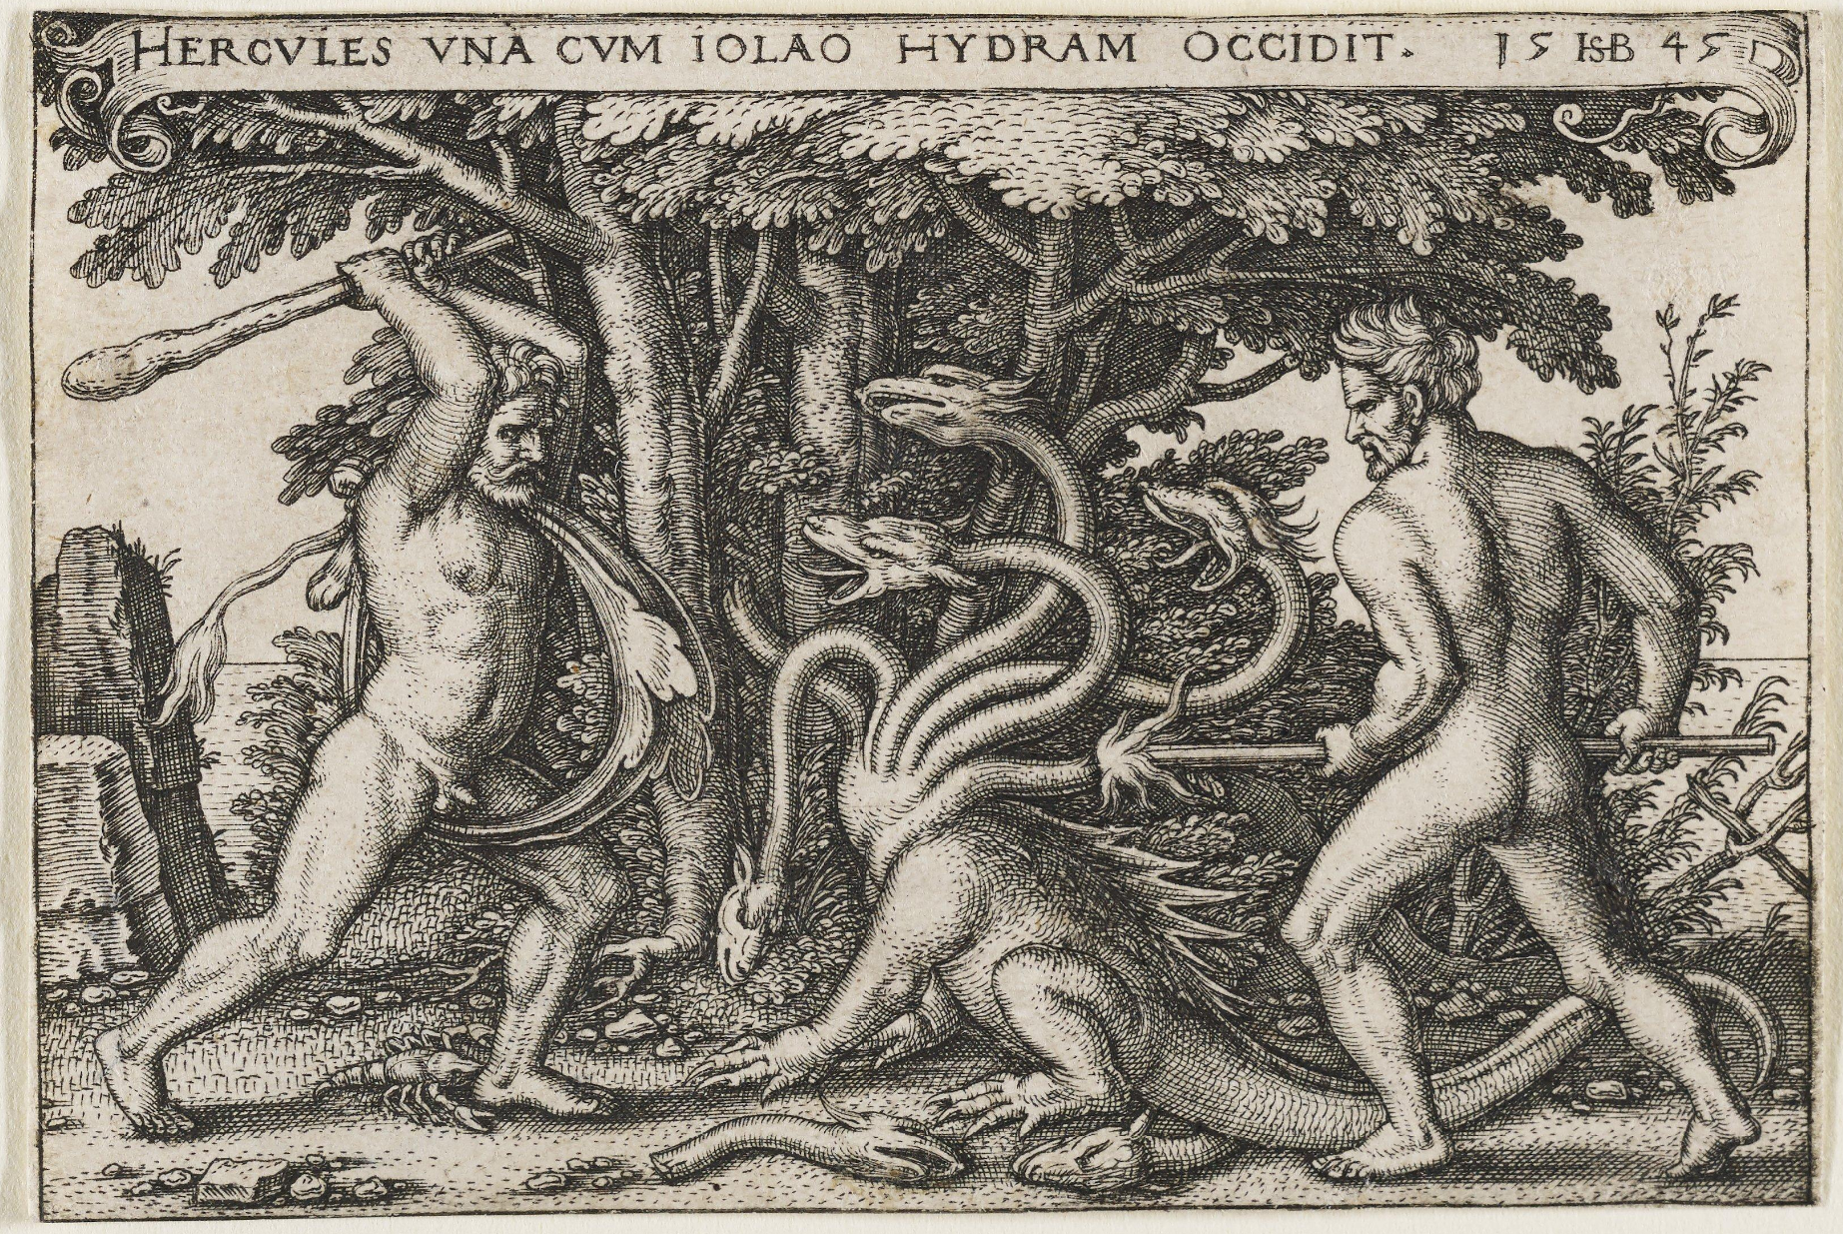

Slide 9


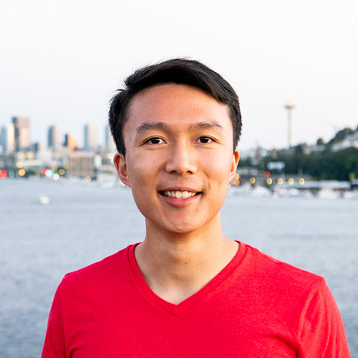



Hello, Class!

Slide 10


Addressing Me
You: How do you pronounce崔?
"Kwee"? "Kway?" …
Professor Brian
Professor Cui (as in "Kwee")
Professor Cui (as in "崔")

Slide 11
Class Objectives
Understand and apply object-oriented design principles in programming
Inheritance, Encapsulation, Polymorphism
Write code that is efficient, extendable, and maintainable
Data Structures, SOLID Principles (Reading), Modular Design
Learn how to think critically about program implementation decisions
Test-Driven Development, Exams
Gain exposure to industry standard tools and techniques
Command-Line, Git, IntelliJ

Slide 12

Prerequisites: Is This Class for You?
Strong understanding of programming constructs required
Variables, conditionals, loops, functions
Java knowledge preferred but not necessary
Significant time commitment
6-10+ hours/week on projects and studying
Lots of problem solving
Independent research and experimentation
No "cookie cutter" solutions
Do you enjoy programming?

Slide 13
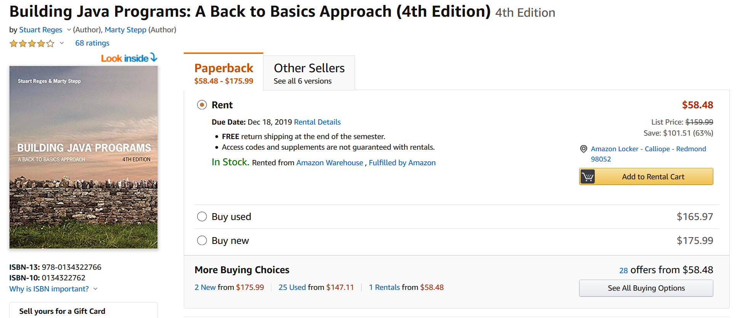
$$$
[OPTIONAL]

Slide 14

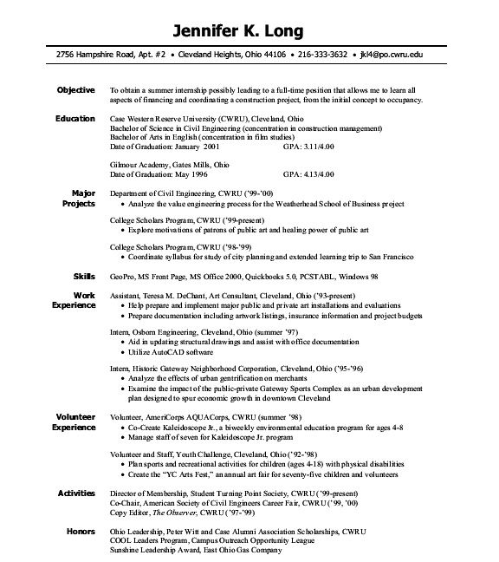
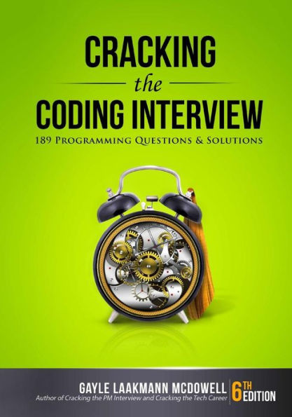

Get a Job!

Slide 15
Class Website & Syllabus
briancui.com/csc-143

